Slide 1


Wake Up Dr. ThomAS! – your python alarm clock
By Fortune onwuzuruike & Janae Logan

Slide 2


Purpose
create a simple, yet effective alarm clock

Slide 3
Tools
Hardware
software
MacBook pro
Asus laptop
GitHub
Visual studio code
Idle
PowerPoint
YouTube

Slide 4
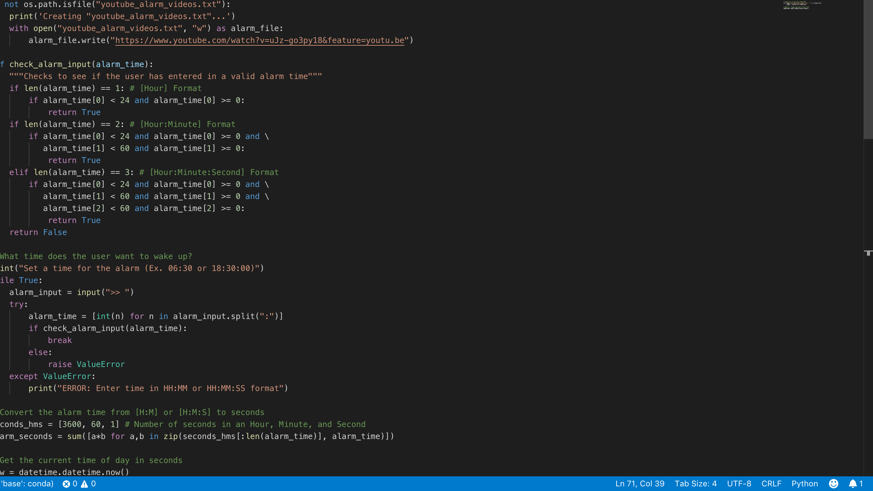
code
This code was found on GitHub and modified to our specifications
Notes:
This will open Visual Studio Code on my computer and take us to the code when “specifications” is clicked.

Slide 5
process
Phase I
Phase ii
Phase iii
Chose and Researched alarm clock topic
Topic write up
Set up repository on GitHub
Acclimated with GitHub
Build video in PowerPoint
Upload video on YouTube
Build text file for python code with video URL
Build rest of code
Test overall code
Figure out alarm clock time (military or am/pm)
run final code
Watch video when alarm goes off
Test code for bugs
Prepare for presentation

Slide 6
challenges
Figuring out the time in python
Researching how to change time format within python

Slide 7
Lessons learned
GitHub is the G.O.A.T.
Access to unlimited information for code modifications
Two heads are better than one
Never hit the snooze button- our code doesn’t have one ☺

Slide 8
Questions?

